Slide 1
Maharaja Agrasen Institute of Technology ETCS 211 Computer Graphics & Multimedia UNIT 1
BRESENHAM’S AND MID-POINT CIRCLE DRAWING ALGORITHMS

Slide 2
Scan Conversion
It is the responsibility of the graphics system or the application program to convert each primitive from its geometric definition into a set of pixels that make up the primitive in the image space.
This conversion task is generally referred to as scan conversion or rasterisation.

Slide 3
Scan Converting a Circle
A circle is a symmetric figure. Any circle generating algorithm can take advantage of the circle’s symmetry to plot eight points for each value that the algorithm calculates.
Eight way symmetry is used by reflecting each calculated point around each 45 º axis.

Slide 4
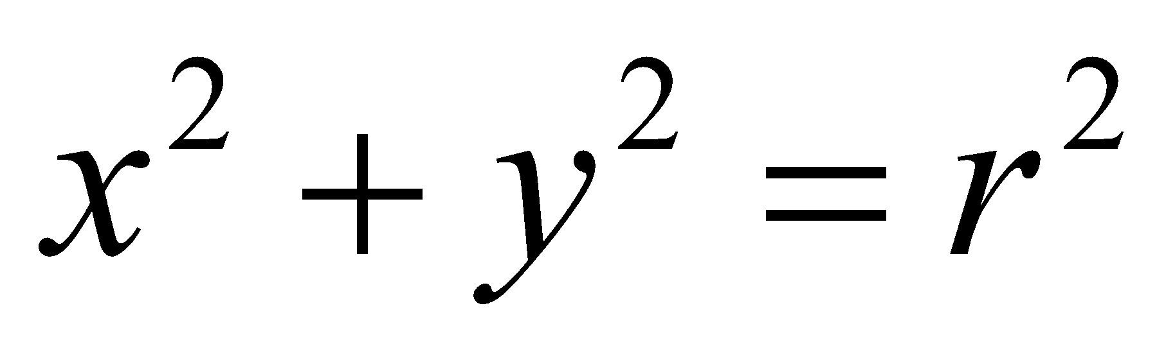
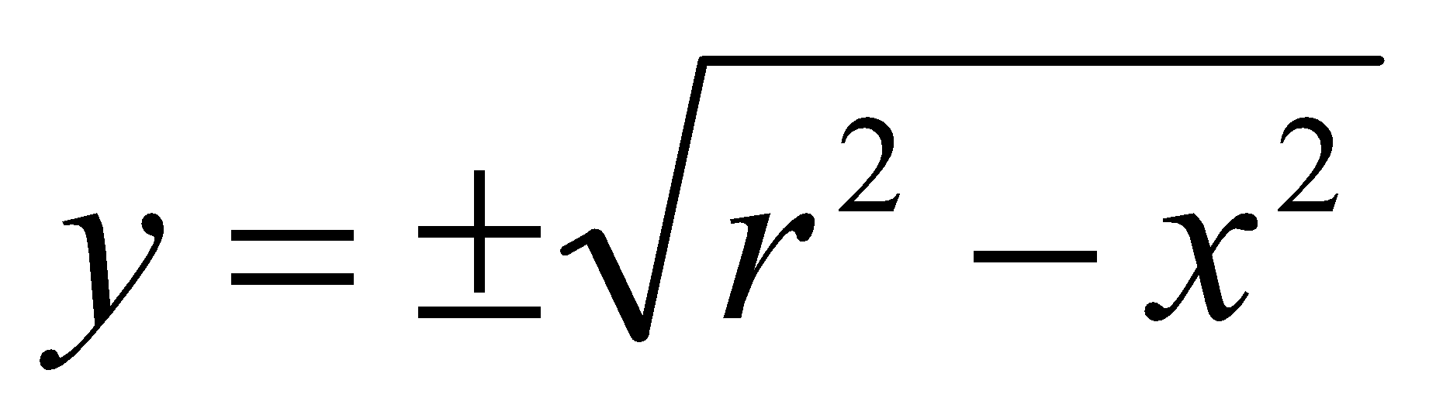
A Simple Circle Drawing Algorithm
The equation for a circle is:
where r is the radius of the circle
So, we can write a simple circle drawing algorithm by solving the equation for y at unit x intervals using:

Slide 5
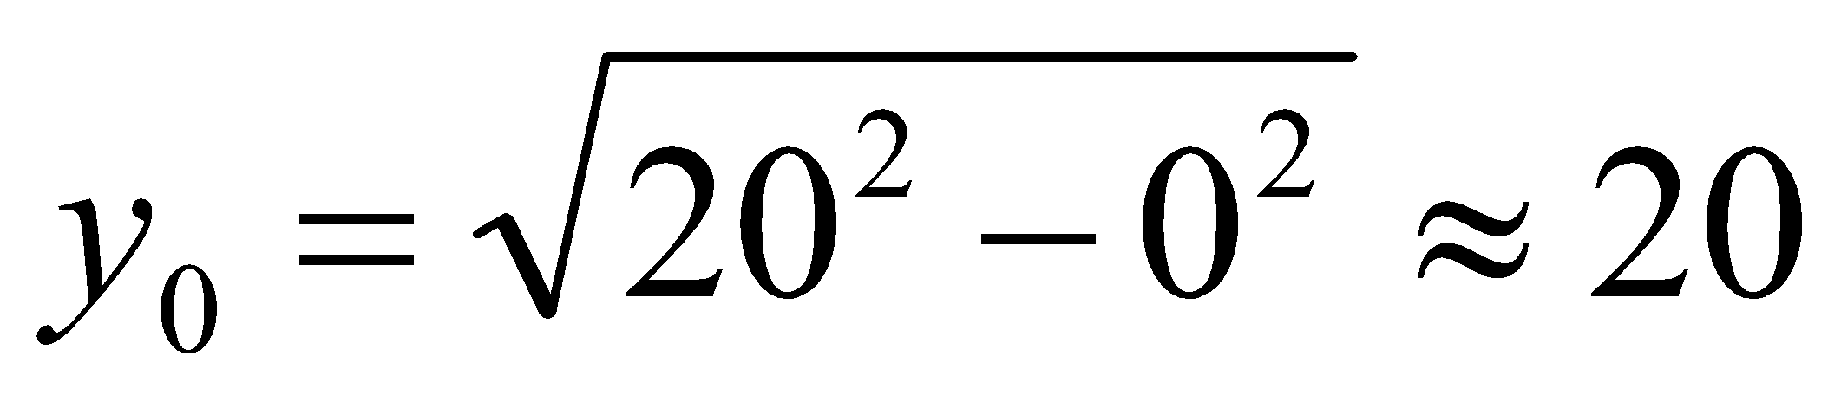
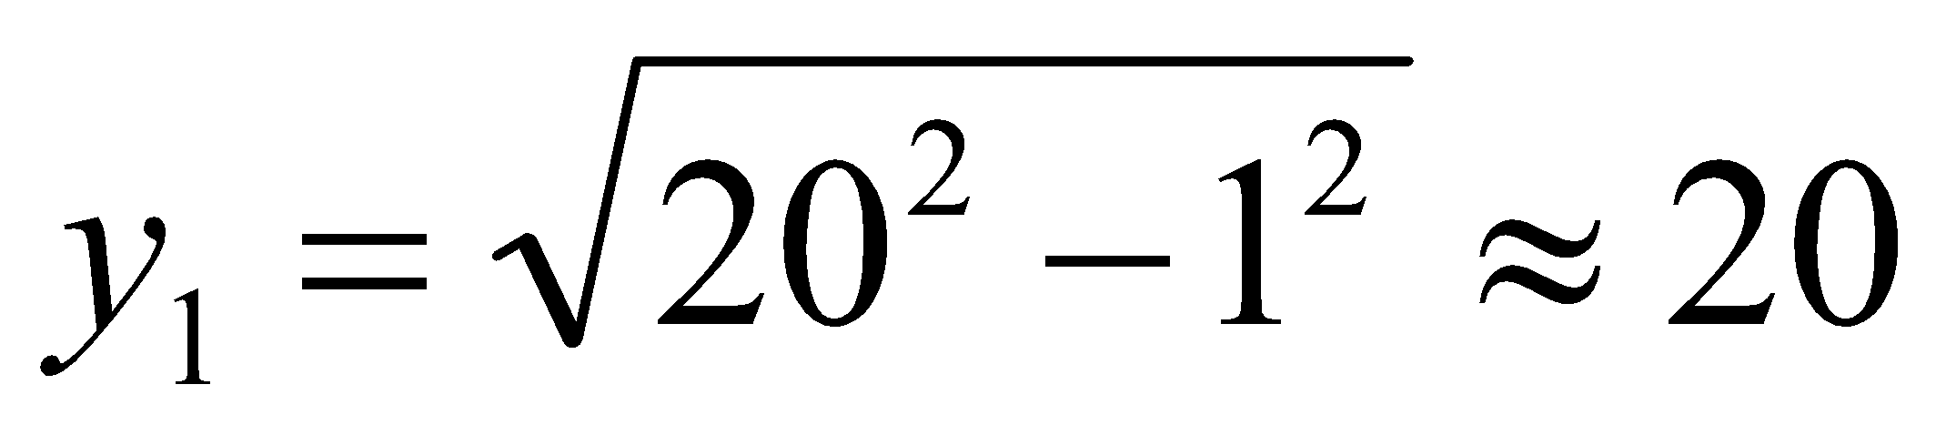
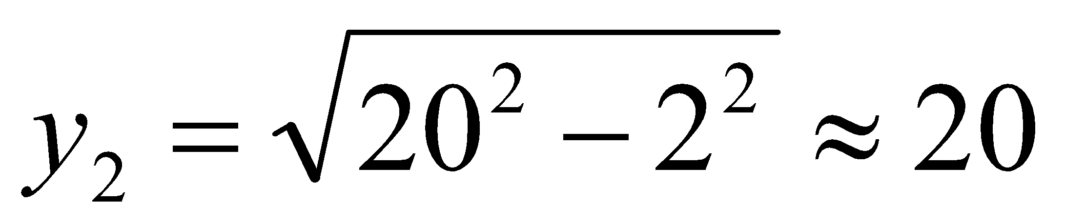
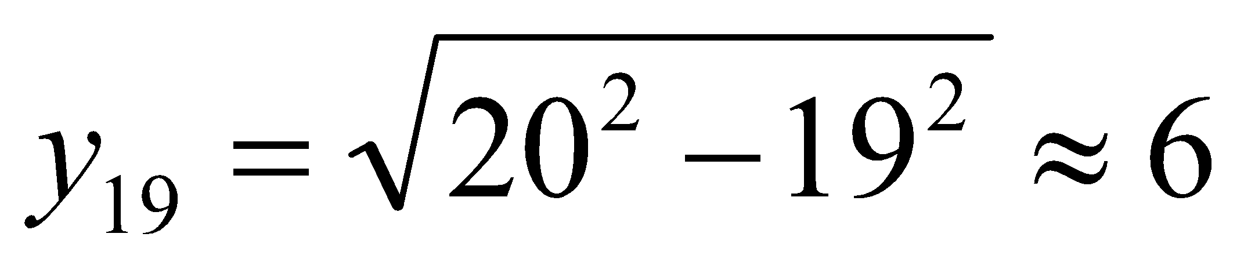
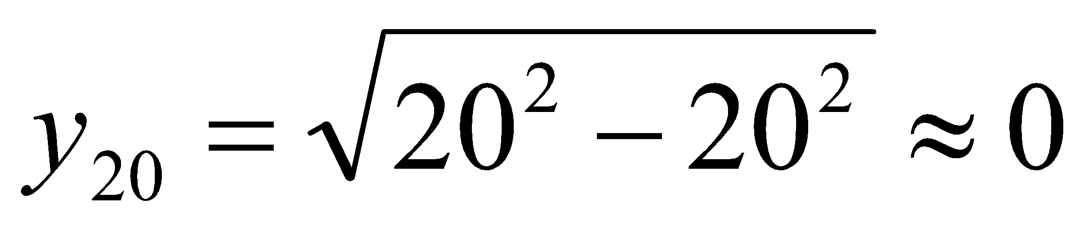
A Simple Circle Drawing Algorithm (cont…)

Slide 6
A Simple Circle Drawing Algorithm (cont…)
However, unsurprisingly this is not a brilliant solution!
Firstly, the resulting circle has large gaps where the slope approaches the vertical
Secondly, the calculations are not very efficient
The square (multiply) operations
The square root operation – try really hard to avoid these!
We need a more efficient, more accurate solution

Slide 7
Polar coordinates
X=r*cosθ+x_{c}
Y=r*sinθ+y_{c}
0º≤θ≤360º
Or
0 ≤ θ ≤6.28(2*π)
Problem:
Deciding the increment in θ
Cos, sin calculations

Slide 8
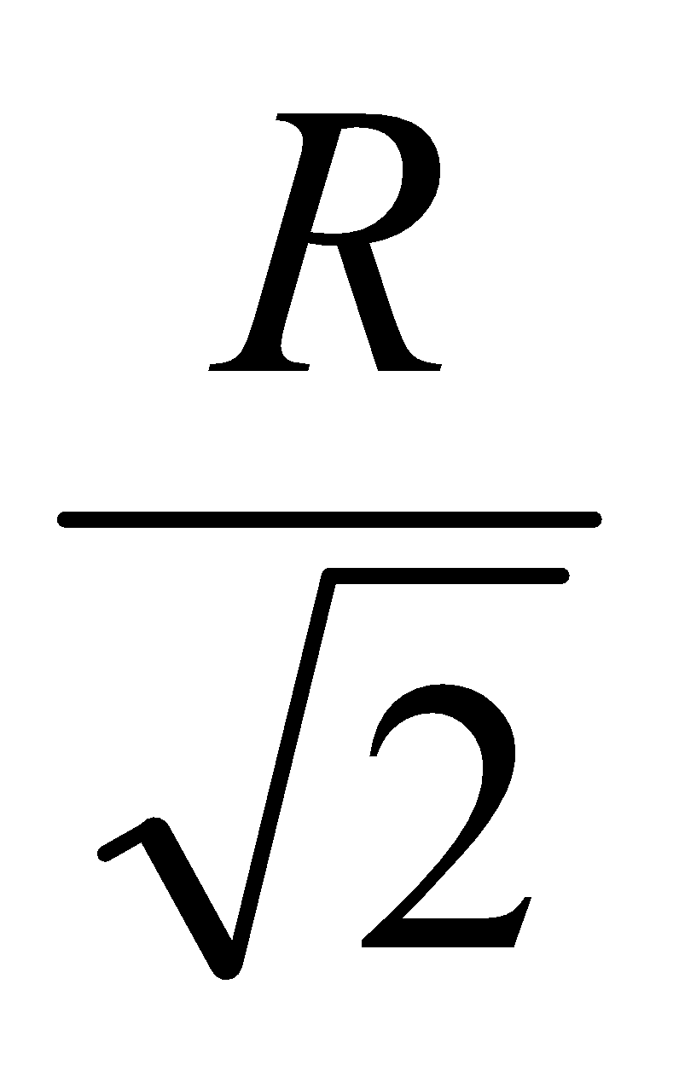
Eight-Way Symmetry
The first thing we can notice to make our circle drawing algorithm more efficient is that circles centred at (0, 0) have eight-way symmetry
(-x, y)
(x, y)
(-y, x)
(y, x)
(-y, -x)
(y, -x)
(-x, -y)
(x, -y)

Slide 9
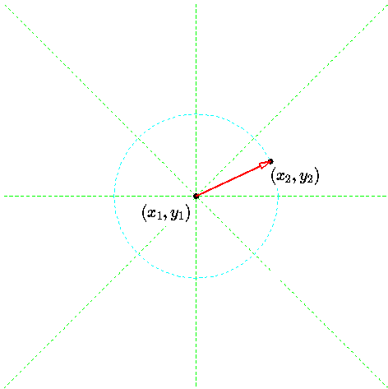
y
-y,x
y,x
-x,y
x,y
x
-x,-y
x,-y
y,-x
-y,-x

Slide 10
Defining a Circle using polynomial method:-
This method defines a circle with second
order polynomial equation
y² = r² – x²
where x, y = x & y coordinates, r = radius
With this method, each x coordinate in the
sector, from 90º to 45º, is found by stepping
x from 0 to r / 2 ,
Each y coordinate is found by
evaluating r² – x² for each step of x.

Slide 11
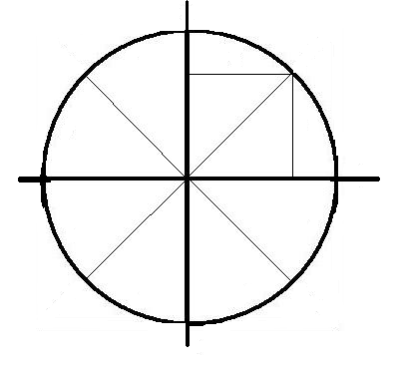
This is a very inefficient method, however, because for each point both x & r must be squared and subtracted from each other.
Then the square root of the result must be found.
y
P(x, r² – x² )
y
r
x
0
x

Slide 12
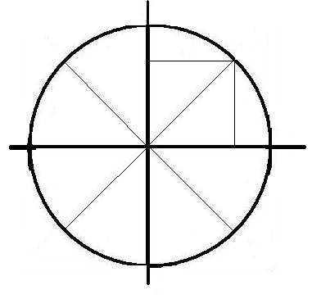
Defining a Circle using trigonometric method:-
This second method of defining a circle uses functions : x = r cos θ, y = r sin θ
y
P(r cos θ,r sin θ)
r sin θ
θ
x
r cos θ

Slide 13
θ = current angle, r = circle radius
By this method θ is stepped from θ to π /4
& each value of x & y is calculated.
Computation of values of sin θ & cos θ are
very time consuming as compared to the first method.

Slide 14
Bresenham’s Circle Algorithm
Working:
If the eight-way symmetry of a circle is
used to generate a circle, points will have to be
generated through 45º angle.
If points are generated from 90º and 45º ,each new point closest to the true circle can be found by taking either of two actions:
Move in the x direction one unit or
Move in the x direction 1 unit & -ve y direction 1 unit.

Slide 15
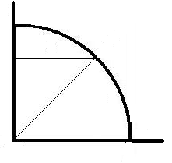
Bresenham’s Circle Algorithm
y
T
(xi+1,yi)
yi
(xi+1,yi-1)
yi -1
S
r
xi
xi + 1
x

Slide 16
Bresenham’s Circle Algorithm
Assume that (xi, yi) are the coordinates of the last scan-converted pixel upon entering step i.
Let the distance from the origin to pixel T squared minus the distance to the true circle squared = D(T) = t² – r².
And let the distance from the origin to pixel S squared minus the distance to the true circle squared = D(S) = s² – r².
Coordinates of T are (xi +1, yi)
S are (xi +1, yi – 1)

Slide 17
Bresenham’s Circle Algorithm
Following expressions can be developed:
D(T) = (xi + 1)² + yi² – r²
D(S) = (xi + 1)² + (yi – 1)² – r²
This function D provides a relative
measurement of the distance from the center
of a pixel to the true circle.
Since D(T) is always +ve (T is outside the circle) & D(S) will always be –ve (S is inside the true circle),
a decision variable di can be defined as:
di = D(T) + D(S)

Slide 18
Bresenham’s Circle Algorithm
Therefore,
di = 2(xi + 1)² + yi² + (yi – 1)² – 2r²
When di<0, we have |D(T)|<|D(S)| and pixel T is chosen.
When di>=0, we have |D(T)|>|D(S)| and pixel S is selected. Decision variable for next step:
d_{i+1} = 2(x_{i+1} + 1)² + y_{i+1}² + (y _{i+1} – 1)² – 2r²

Slide 19
Bresenham’s Circle Algorithm
Hence,
d_{i+1} – di = 2(x_{i+1} + 1)² + y_{i+1}² + (y_{i+1} – 1)² -
2(xi + 1)² - yi² - (yi – 1)²
Since x_{i+1} = xi + 1, we have
d_{i+1} = di + 4xi + 2(y_{i+1}² - yi²) – 2(y_{i+1} – yi) + 6
🡺If T is chosen pixel (meaning that di < 0) then y_{i+1} = yi and so d_{i+1} = di + 4xi + 6
🡺If S is chosen (meaning that di > 0) then y_{i+1} = yi –1 and so d_{i+1} = di + 4(xi-yi) + 10

Slide 20
Bresenham’s Circle Algorithm
Hence we have
d_{i+1} = di + 4xi + 6 if di < 0
di + 4(xi-yi) + 10 if di > 0
Finally, we set(0,r) to the starting pixel coordinates and compute d1 from the original definition of di:
x = 0, y = r
d1= 2(0 + 1)² + r² + (r-1)² – 2r²
= 3 – 2r

Slide 21
Algorithm:
For generating all the pixel coordinates in the
90º to 45º octant that are needed when scan-
converting a circle of radius r.
int x = 0, y = r, d = 3-2r
while (x <= y)
{
setpixel(x,y)
if (d < 0)
d = d + 4x + 6

Slide 22
else
{
d = d + 4(x - y) + 10
y--
}
x++
}

Slide 23
Midpoint Circle Algorithm
Circle equation : f(x,y) = x² + y² – r²
Any point on the circumference of the circle will satisfy the above equation.
Hence :
>0 🡺 Point is outside the boundary of the circle
f(x,y) =0 🡺 Point is on the boundary of the circle
< 🡺 Point is inside the boundary of the circle

Slide 24
Midpoint Circle Algorithm
Now consider the coordinates of the point halfway between pixel T & S (xi + 1, yi – ½) This is called the midpoint and we use it to define a decision parameter:
pi = f( xi +1, yi – ½) = (xi + 1)2 + (yi – ½)2 –r2
If pi is –ve , the midpoint is inside the circle, then we choose pixel T.
If pi is +ve, the midpoint is outside the circle, & we choose S.
Similarly,
pi+1 = (xi+1 + 1)2 + (yi+1 – ½)2 – r2

Slide 25
Midpoint Circle Algorithm
pi+1 = pi + 2(xi+ 1) + 1 + (y i+1 2 – yi2) – (y i+1 – yi)
If pixel T is chosen (meaning pi < 0), we
have yi+1 = yi.
If pixel S is chosen (meaning pi > 0), we have yi+1 = yi – 1. Thus,
In terms of (xi, yi), we have
pi+1= pi + 2xi + 3 if pi<0
pi + 2(xi - yi ) + 5 if pi>=0

Slide 26
Midpoint Circle Algorithm
Finally, we compute the initial value for the decision parameter using the original definition of pi and (0,r):
pi = (0 + 1)2 + (r – ½)2 – r2 = 5/4 – r
One can see that this is not really integer computation. However, when r is an integer we can simply set p1= 1 – r

Slide 27
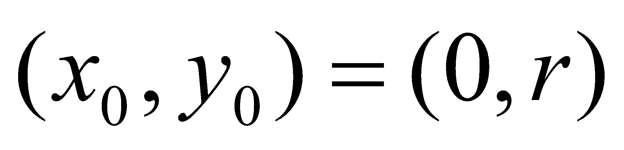
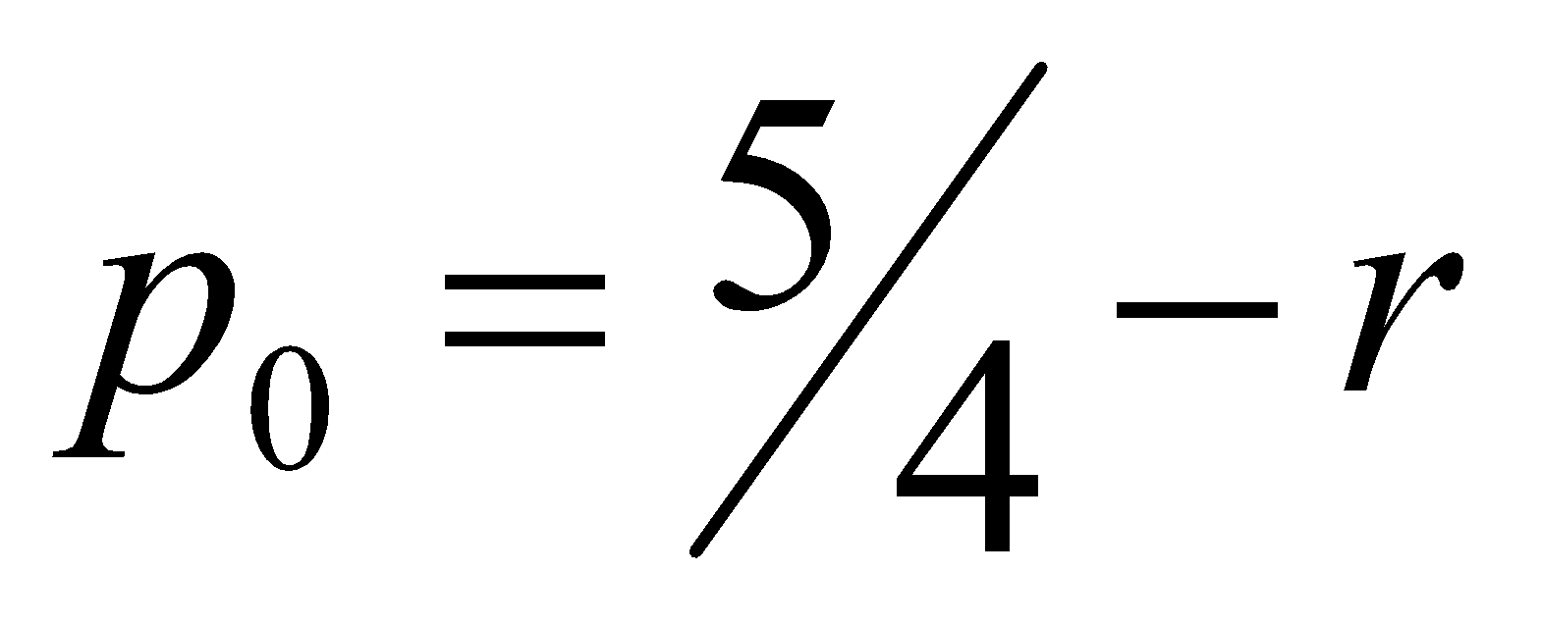
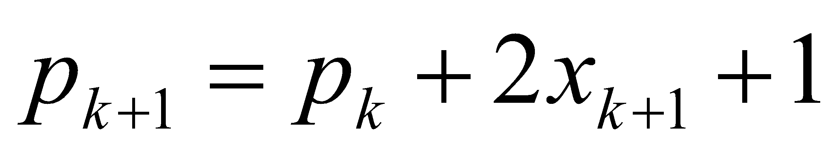
The Mid-Point Circle Algorithm
MID-POINT CIRCLE ALGORITHM
Input radius r and circle centre (x_{c}, y_{c}), then set the coordinates for the first point on the circumference of a circle centred on the origin as:
Calculate the initial value of the decision parameter as:
Starting with k = 0 at each position x_{k}, perform the following test. If p_{k} < 0, the next point along the circle centred on (0, 0) is (x_{k}+1, y_{k}) and:

Slide 28
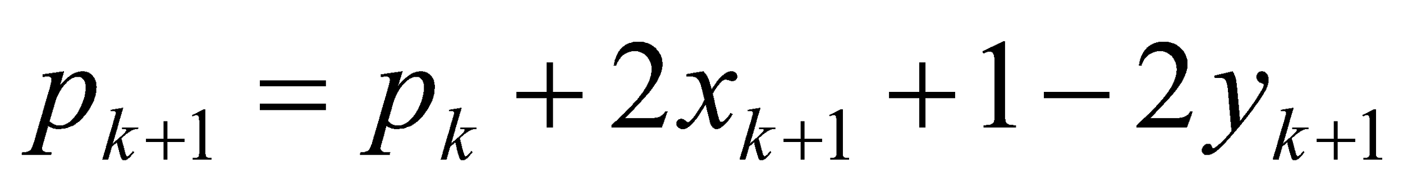
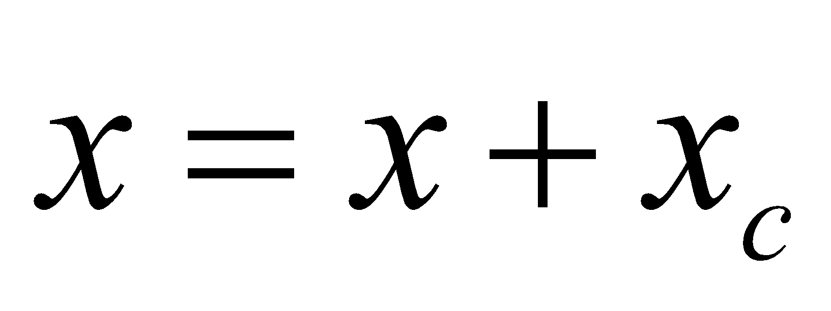
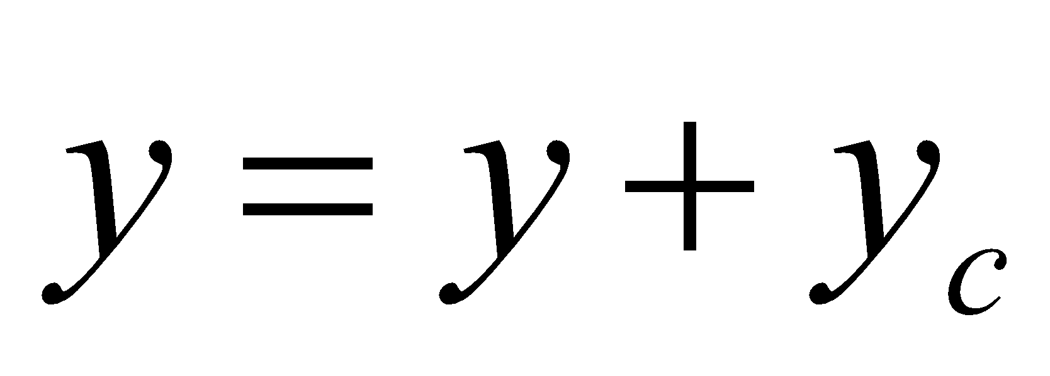
The Mid-Point Circle Algorithm (cont…)
Otherwise the next point along the circle is (x_{k}+1, y_{k}-1) and:
Determine symmetry points in the other seven octants
Move each calculated pixel position (x, y) onto the circular path centred at (x_{c}, y_{c}) to plot the coordinate values:
Repeat steps 3 to 5 until x >= y

Slide 29
Algorithm
1. Input radius r and centre of the circle (x_{c}, y_{c}), and obtain the first point on the circumference of a circle centred on the origin as
(x₀, y₀) = (0, r)
2. Calculate the initial value of the decision parameter as
P₀ = 1 – r
where r is the radius of the circle

Slide 30
Midpoint Circle Algorithm
3. At each x_{k} position, starting at k= 0, perform the following test:
If (P_{k} < 0), then the NEXT POINT along the circle centred on (0, 0) is
(x_{k+1}, y_{k}) and P_{k+1} = P_{k} + 2x_{k+1} +1
🡺 P_{k+1} = P_{k} + 2x_{k} + 3
Otherwise, the NEXT POINT along the circle is
(x_{k+1}, y_{k–1}) and P_{k+1} = P_{k} + 2x_{k+1} + 1 – 2y_{k+1}
🡺 P_{k+1} = P_{k} + 2x_{k} – 2y_{k} + 5

Slide 31
Midpoint Circle Algorithm
4. Determine the Symmetry Points on the other 7 Octants
5. Move each calculated pixel position (x,y) onto the circular path centered at (x_{c},y_{c}) and plot the coordinate values as
x = x + x_{c} and y = y + y_{c}
6. Repeat steps 3 to 5 until x >= y

Slide 32
Arbitrarily Centered Circles
To scan-convert a circle centered at (x1,y1), we can simply replace the setPixel(x,y) statement in the algorithm description with setPixel(x+x1,y+y1). This is because a circle centered at(x1,y1) can be viewed as a circle centered at origin that is moved by x1 and y1 in the x and the y direction.

Slide 33
Q & A
1.The midpoint circle drawing algorithm also uses the __of the circle to generate?
two-way symmetry
four-way symmetry
eight-way symmetry
both a & b
2. A circle, if scaled only in one direction becomes a ?
parabola
hyperbola
ellipse
remains a circle

Slide 34
3.Let R be the radius of a circle. The angle subtended by an arc of length R at the center of the circle is ?
1 degree
1 radian
45 degree
impossible to determine

